Slide 1
The need for standards in chemical information
Evan Bolton, Ph.D. – Chemistry Program Head

Slide 2






There are multiple standard organizations
(small sampling below)
https://rd-alliance.org/
http://www.codata.org/
https://iupac.org/
https://www.w3.org/
https://www.cdisc.org
https://iubmb.org/

Slide 3

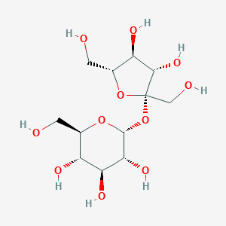
Standards examples
Nomenclature
Chemical naming
Used in software for structure→name and name→structure
Biological Line notations (with IUBMB) for saccharides, proteins
Terminology
Color books
beta-D-arabino-hex-2-ulofuranosyl alpha-D-gluco-hexopyranoside
Glc(a1-2b)Fruf
Sucrose

Slide 4
Standards examples
Version Type
Chemical formula
Connectivity
Charge&Proton
Stereochemical
Other (e.g., Isotopic)
InChI
International Chemical Identifier
Standard
Initially created by NIST
Under auspices of IUPAC (2004)
Open source, non-proprietary
Layered design
Algorithm
Normalizes chemical representation
Includes layered ‘hashed’ form called an InChIKey (fixed length)
InChI=1S/C12H22O11/c13-1-4-6(16)8(18)9(19)11(21-4)23-12(3-15)10(20)7(17)5(2-14)22-12/h4-11,
13-20H,1-3H2/t4-,5-,6-,7-,8+,9-,10+,
11-,12+/m1/s1
CZMRCDWAGMRECN-
UGDNZRGBSA-N

Slide 5

Example use case for InChI or InChIKey: Quickly map your records to other resources
PubChem FTP site provides a complete tab-delimited file containing all +95M chemicals
PubChem Compound Identifier (CID), InChI, InChIKey
ftp://ftp.ncbi.nlm.nih.gov/pubchem/Compound/Extras/CID-InChI-Key.gz
Compute InChI/Key for your records
Compare InChI/Key strings (or DB join)
InChI/Key
Your chemical collection
==

Slide 6
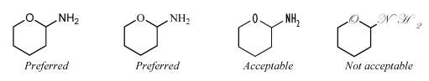
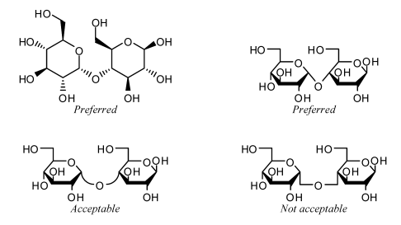
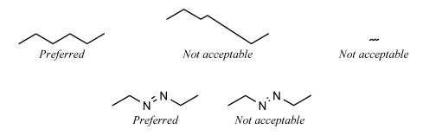
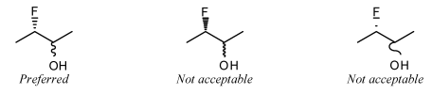
Standards examples
Graphical Representation Standards for Chemical Structure Diagrams (2008)

Slide 7

Scientific information needs standards
Schemes
Presentation
Data
Text
Tables
PDF
Images
Human
understanding
HTML
Text
Figures

Slide 8

Scientific information needs standards
Presentation
Data
Text
Schemes
PDF
Tables
Computers just don’t get it
Images
Figures
Text
HTML
Image credit:
https://static.spiceworks.com/attachments/cms/0000/2161/sad-computer.png
Notes:
But .. Nearly all information is geared towards human understanding .. Text, tables, schemes, figures
Humans are rather inventive with new terms or in how they communicate results

Slide 9

The chemical information divide
understanding
v
Human
understanding
Computer
understanding
Human
Intent
scientific content interpreted no matter the form
scientific content interpreted into terms and relationships
Image credit:
https://hcldr.files.wordpress.com/2016/12/1-rr-0116-industry-divided.jpg
Notes:
Natural Language Processing - NLP interprets (“reads”) human text
Identifies entities – chemicals, genes, proteins, diseases, organisms, etc. – Name/entity relationship (NER)
Identifies relationships between entities .. Very tough problem
The chemical information divide is already here .. We use computers everywhere in chemical information

Slide 10
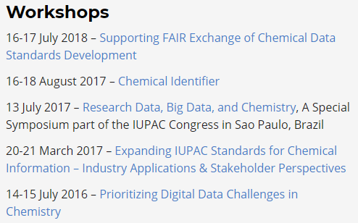
Towards digital standards
Committee on Publications and Cheminformatics Data Standards (CPCDS)
Subcommittee on Cheminformatics Data Standards (SCDS)
Working towards digital standards for chemical information
with other scientific organizations, such as NIST, CODATA, and the Research Data Alliance (RDA)

Slide 11
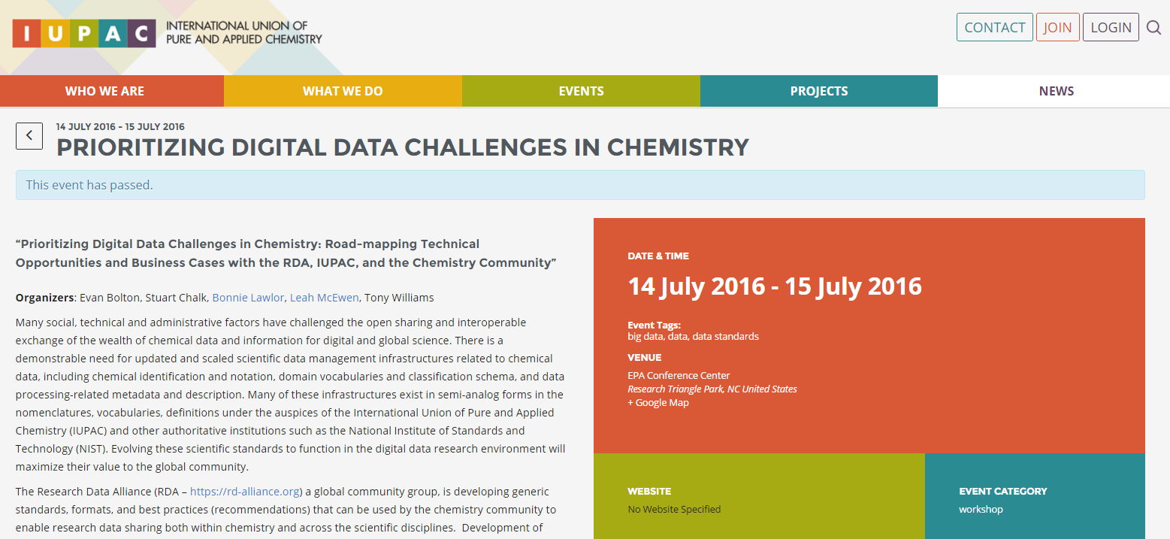
RDA/IUPAC CPCDS Workshop at EPA

Slide 12
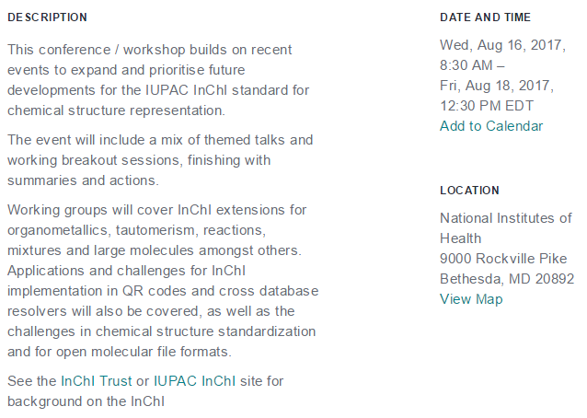

Workshop on future of InChI
http://www.inchi-trust.org/
Aug. 16-18, 2017

Slide 13
InChI still being developed: Reactions RInChI multi-component system notation
Esterification of acetic acid with ethanol to acetic acid and water catalyzed by sulfuric acid:
RInChI=0.03.1S /C2H4O2/c1-2(3)4/h1H3,(H,3,4)! C2H6O/c1-2-3/h3H,2H2,1H3 <> C4H8O2/c1-3-6-4(2)5/h3H2,1-2H3!
H2O/h1H2 <> H2O4S/c1-5(2,3)4/h(H2,1,2,3,4) /d+
"<>" separates reactants, products, and agents (= catalysts, solvents, etc.)
”!" separates components within these groups
alphabetical order of components within groups
/d+ layer describes the direction of the reaction
("RInChI=0.03.1S” version identifier)

Slide 14
InChI still being developed: Mixtures MInChI example w/ concentration range notation
37% wt. Formaldehyde in Water with 10-15% Methanol:
MInChI=0.00.0S/ CH2O/c1-2/h1H2& CH4O/c1-2/h2H,1H3& H2O/h1H2
/n{1&2&3}
/g{37wf-2&10-15vf-2&}
alphabetical order of components
”&" separates components
”{}” denotes mixture groups
“/n” layer indexes components (e.g., order)
“/g“ layer notates concentration (symbols detailed separately)
(”MInChI=0.00.0S” version identifier)

Slide 15
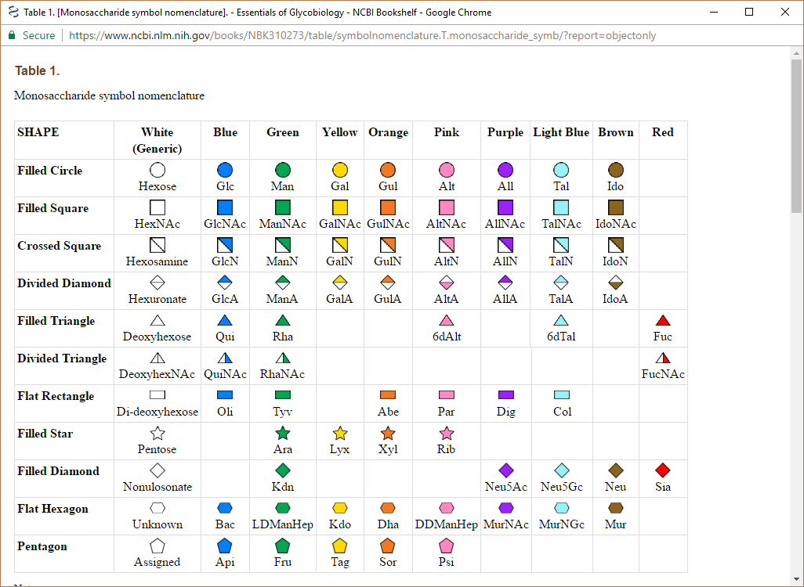
Community Standards
Symbol Nomenclature for (Graphical Representations of) Glycans (SNFG)
Table from Ajit Varki’s Essentials for Glycobiology 3rd edition available on NCBI’s Bookshelf
https://www.ncbi.nlm.nih.gov/glycans/
Many community standards exist

Slide 16
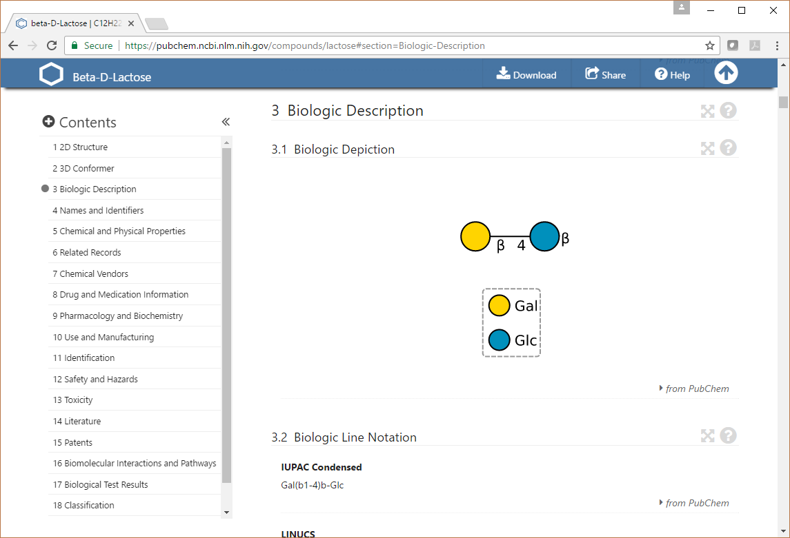
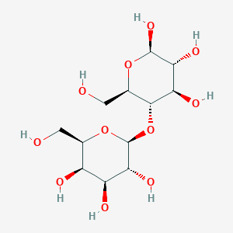
Example of SNFG for Lactose
Symbolic representation in action .. makes for pretty pictures that are way easier to interpret .. if you know what you are looking at …

Slide 17
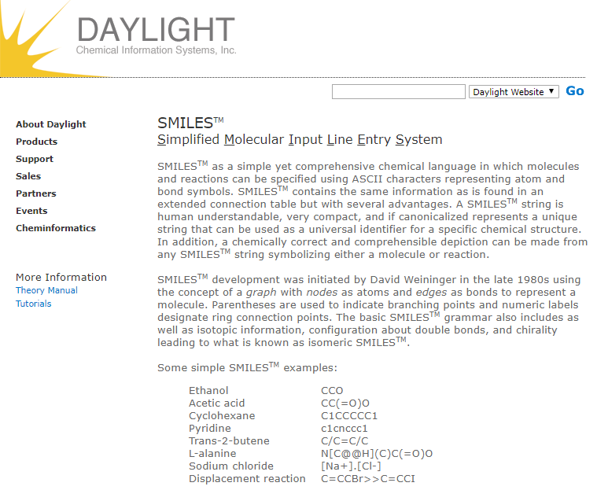
Industry Standards
SMILES
SMARTS
Via Daylight Chemical Information Systems, Inc.
(although last software release was Aug 2011)
http://www.daylight.com/smiles/index.html

Slide 18
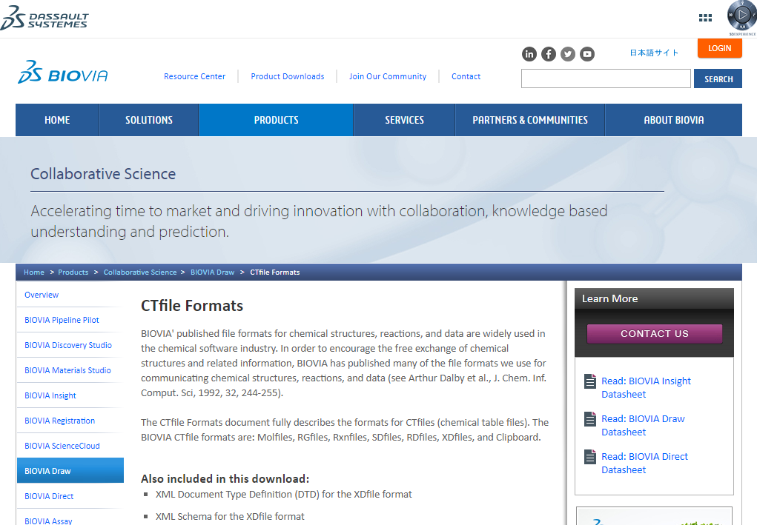
Industry Standards
CTFile formats
includes SDF, MOL, CTAB
Owned by BIOVIA
http://accelrys.com/products/collaborative-science/biovia-draw/ctfile-no-fee.html

Slide 19

We have standards .. some emerging and some in progress. Great! Job done.
Image credit:
http://i0.kym-cdn.com/photos/images/original/000/038/471/20090129_prince2_560x375.jpg

Slide 20
Not so fast….

Slide 21
Chemical (structure) information is and remains rather troublesome...

Slide 22
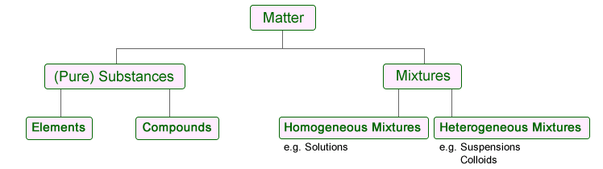
Chemical information is not easy
How do you describe a chemical substance?
No standards for meta data associated with chemical representation (e.g., purity)
How do you describe a chemical mixture?
No standards (InChI?), often free-form text
How do you describe a chemical bioactivity?
Emerging standards, not widely adopted
Minimum Information About a Bioactive Entity (MIABE)
How do you draw a chemical structure?
IUPAC Graphical Representation Standards for Chemical Structure Diagrams
Not widely adopted, large pre-existing corpus
Not tuned for computer understanding
Image credit:
http://www.ivyroses.com/Chemistry/GCSE/What-is-a-substance.php

Slide 23
Variability of chemical information representation is a barrier for computer understanding
and human
v
No “Global” rules or standards
based on individual organizational needs
often based on individual preferences
“depictions” of chemical structures
Data from many organizations
conflicting “business rules”
previously unseen data representation schemes
combinatorial ways of drawing the same structure
This is what normalization is for .. we know how to do this .. just put it in my favorite software and it will fix everything!

Slide 24
Resonance, Tautomerism, Ionization, and Mesomerism
Which form does your software prefer?
Which form do you prefer?
Special thanks to Roger Sayle and Volker Hähnke

Slide 25
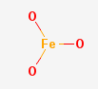
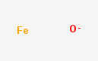
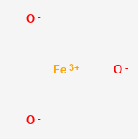
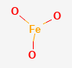
Metals and Oxygen
How to interpret a Metal-Oxygen bond?
Metal oxide?
Metal hydride?
Metal hydrate?
Missing hydrogens .. use of covalent bonds .. no metal bonds .. missing 3-D structure
High-spin, low-spin?
Iron hydroxide
M – O
Iron oxide

Slide 26
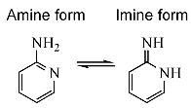
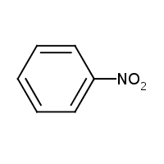
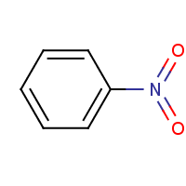
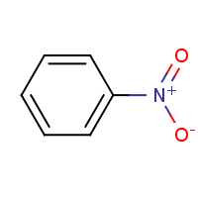
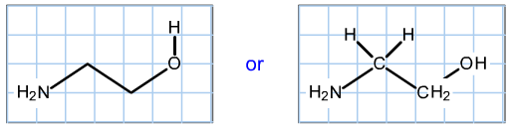
Normalization of chemical information
Comes in many forms and types
Typically, a hidden (behind the scenes) modification of input data to fit the task at hand
Valence corrections (add charge, remove hydrogen)
Hydrogen handling (add, remove, explicit←→implicit)
Aromaticity handling (bond type conversion to/from)
Mobile hydrogen determination (tautomer assignment)
Image credits:
http://54.83.47.241/sites/default/files/hydrogenAtoms01.gif
http://1.bp.blogspot.com/-FFB98pV370M/TglQWNfpUiI/AAAAAAAAAXk/VaQCwlNHpK0/w1200-h630-p-k-no-nu/Tautomers1.gif
http://1.bp.blogspot.com/_vBTAS8Q6YJM/SfgxAwh_FPI/AAAAAAAAAF4/r8pomA1LnZM/s320/PhN%2B%28O-%29O.png
http://4.bp.blogspot.com/_vBTAS8Q6YJM/SfgyY8HGwhI/AAAAAAAAAGI/WGfxyZxNTUo/s320/PhN%28%3DO%292.png
http://2.bp.blogspot.com/_vBTAS8Q6YJM/Sfgxr2U8I5I/AAAAAAAAAGA/hllHzcoyiYY/s320/PhNO2.png

Slide 27
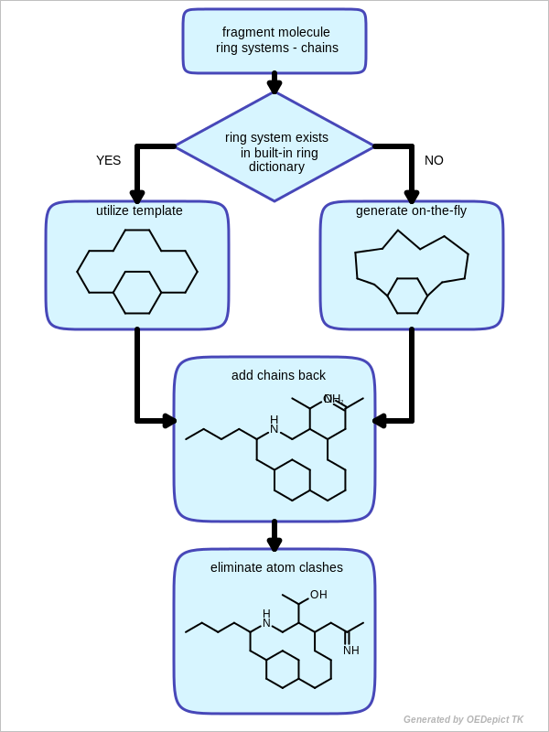
Normalization is a part of everything we do
2-D coordinate generation (also known as ‘clean’)
Placement of wedge/hash bonds
Parity designation
Aromaticity “o” in rings
Image credit:
https://docs.eyesopen.com/toolkits/python/_images/2DCoordinateGgenerationSteps.png

Slide 28
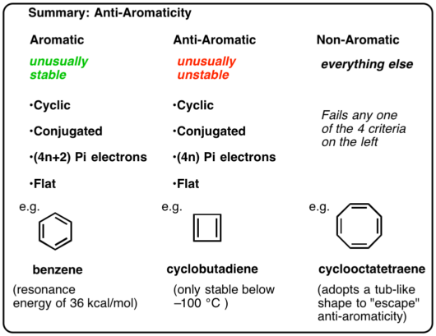
Normalization is a part of everything we do
Aromaticity or Kekulization
Often applied when reading or writing SMILES
Tautomer handling
Depictions
Image credit:
http://11452-presscdn-0-51.pagely.netdna-cdn.com/wp-content/uploads/2017/03/0-summary-e1490383445739.png

Slide 29
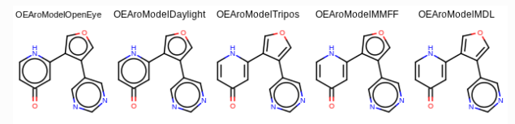
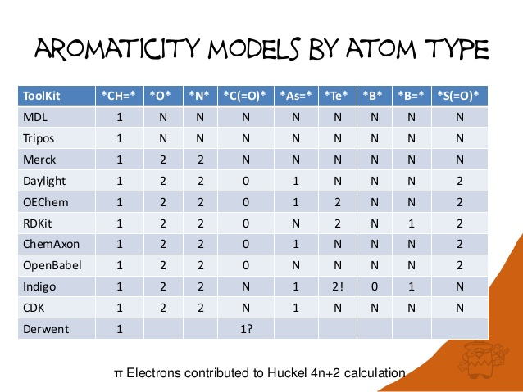
Normalization algorithms (and vendors) do not interpret the same information in the same way
Explicit and Implicit Hydrogens: Taking liberties with valence
Myth #1: There is a single universal valence model
Myth #2: Valence models follow simple patterns
Myth #3: A connection table representing a molecule is interpreted the same way by all programs
Myth #4: Everything is broken in cheminformatics and nothing can be done to fix it
From blog: https://nextmovesoftware.com/blog/2013/02/27/explicit-and-implicit-hydrogens-taking-liberties-with-valence/
Image credita:
https://docs.eyesopen.com/toolkits/python/_images/OEAssignAromaticFlags_Difference.png
https://image.slidesharecdn.com/saylerdkitperspective-130419041155-phpapp02/95/cheminformatics-toolkits-a-personal-perspective-22-638.jpg?cb=1366344772

Slide 30
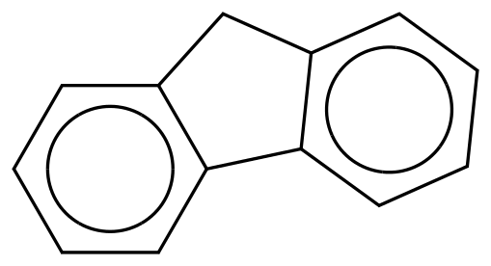


Normalization is tricky
Software (almost always) does normalization by default (cannot turn off?)
Different software does different normalization
Same software, but different version, is different software!
There are a zillion edge cases where algorithms go wrong .. seriously wrong .. meaning your structures are corrupted
Fluorene
Still fluorene?
Image credit:
http://orgsyn.org/httphandlers/substancetooltip.ashx?id=1783

Slide 31
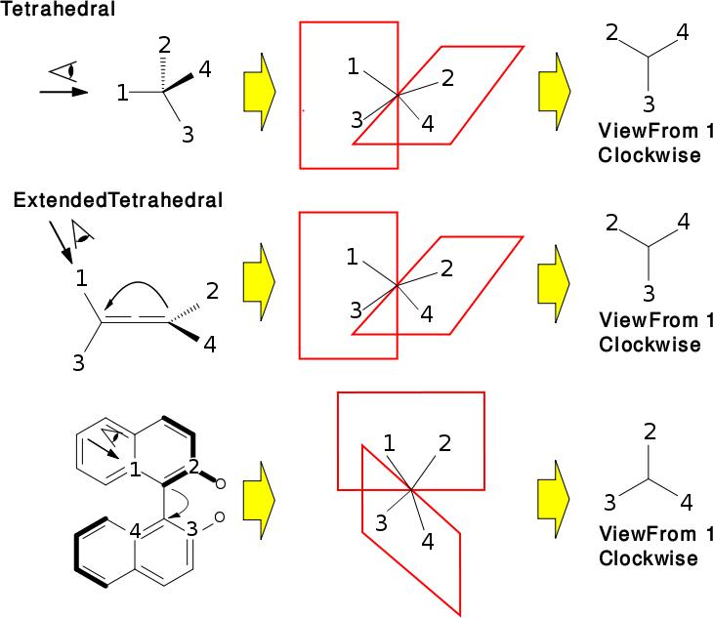
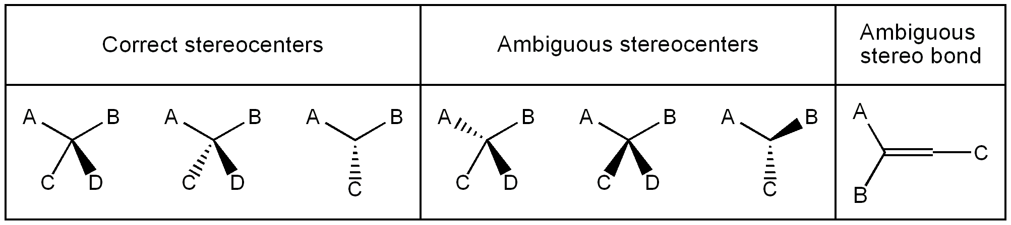
Normalization is a part of everything we do
Stereochemical detection and assignment
Image credit:
https://static-content.springer.com/esm/art%3A10.1186%2F1471-2105-7-517/MediaObjects/12859_2006_1256_MOESM5_ESM.png
Image credit:
http://openbabel.org/dev-api/tetranonplanar.png

Slide 32
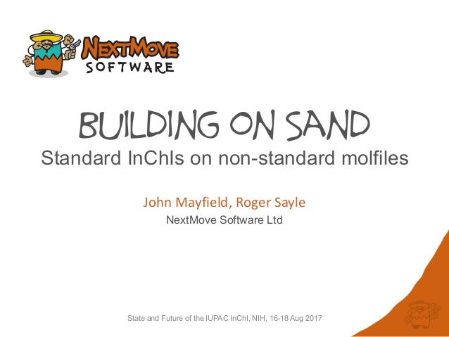
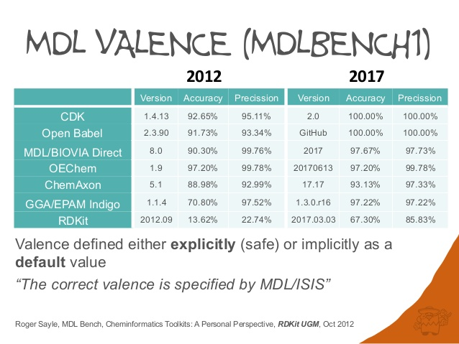
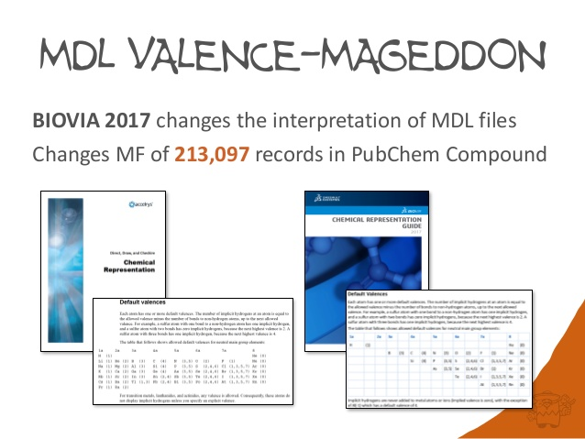
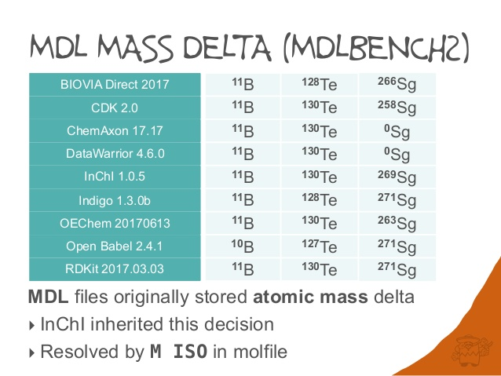
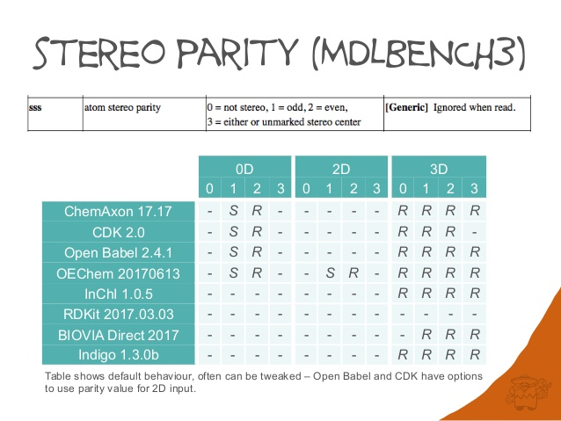
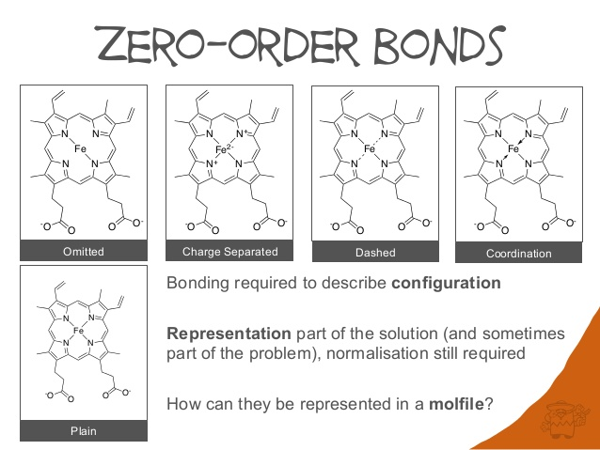
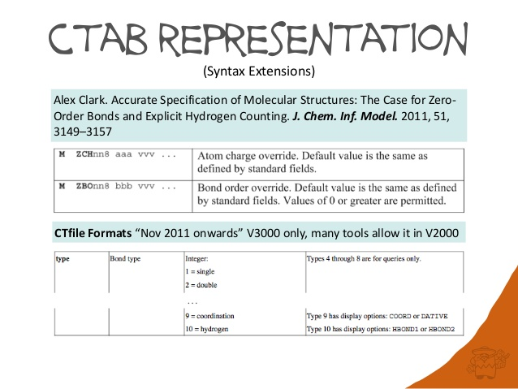
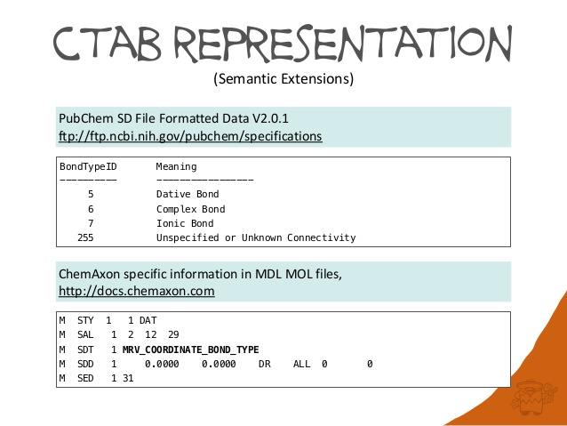
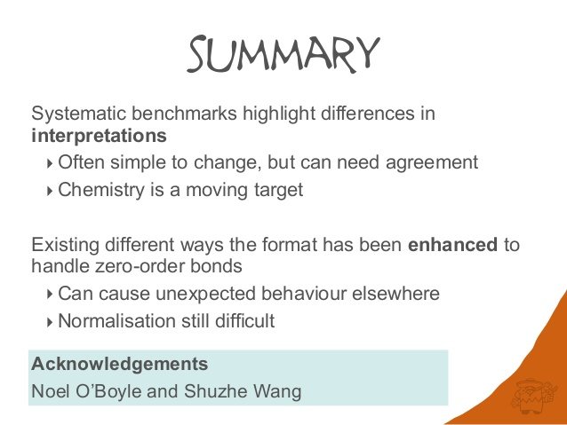
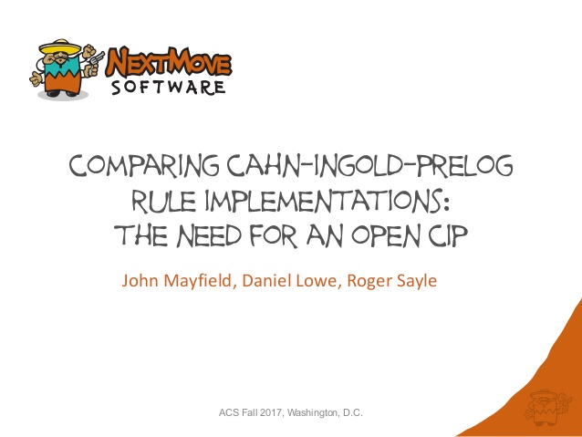
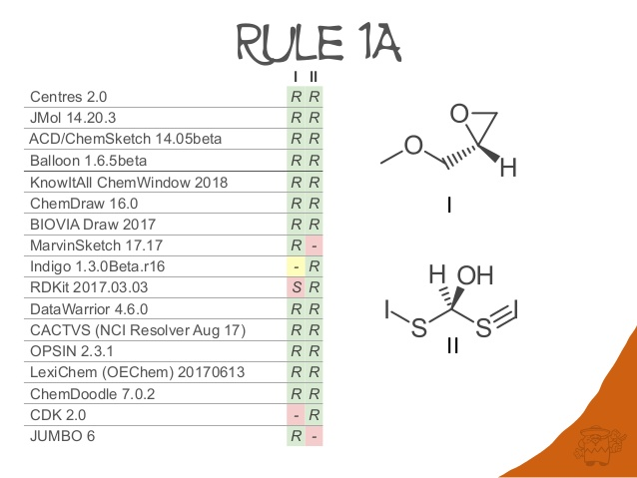
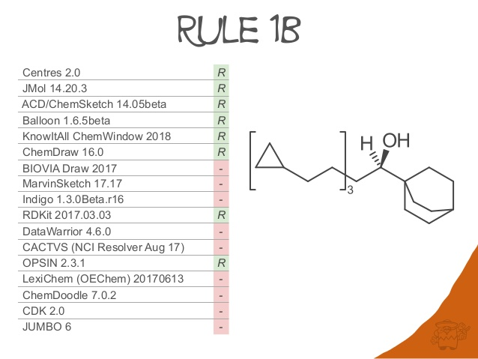
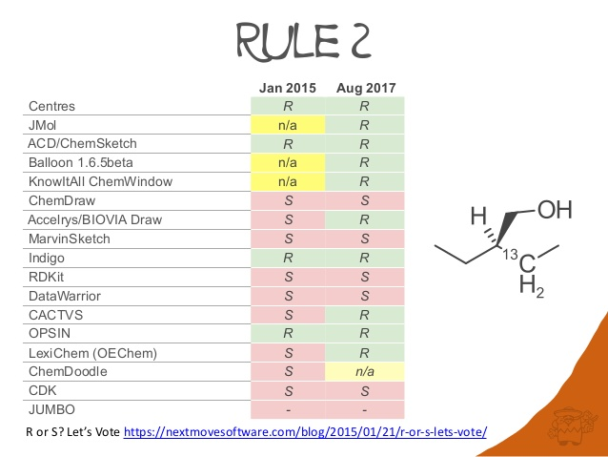
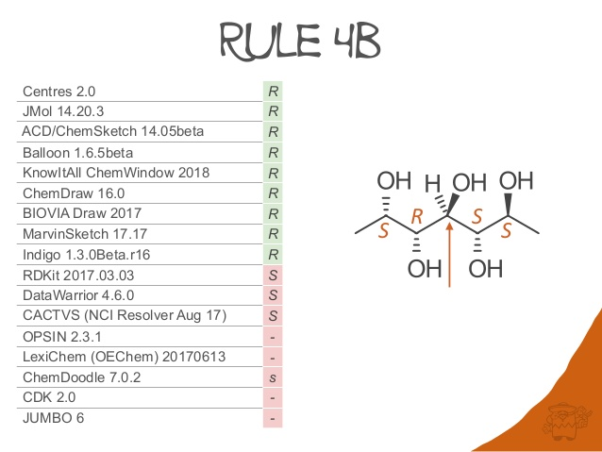
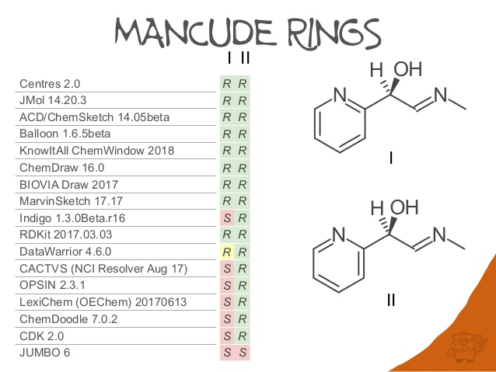

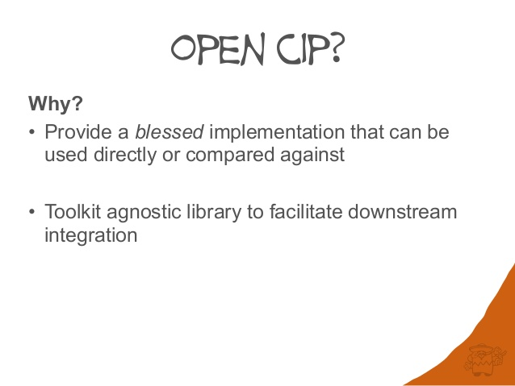
Chemical toolkits don’t behave the same for the same structure
‘Owner’ of industry standards can change things on a whim .. irrespective of community usage of format

Slide 33
Where has this structure been?
PDB
SDF
InChI
SMILES
CDX
Export between file format flavors can result in reinterpretation of structure (2-D coordinates, atom types, bond types, etc.)
Chemical file format interconversion can be lossy

Slide 34
With whom has this structure been?
Chem Draw
OpenEye
Chem Axon
Biovia
Open Babel
Different structure packages support structural information content to different extents
Different software packages may ‘normalize’ your chemical structure in different ways

Slide 35
Free flow of information
Download
Interpret
Normalize
Upload
Algorithms interpret information
Can introduce ambiguity, errors
Later use can mislead
Now cycle this many times
Need ways to lock down knowledge so not corrupted

Slide 36
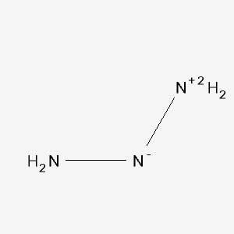
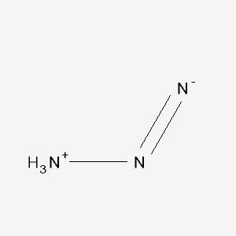
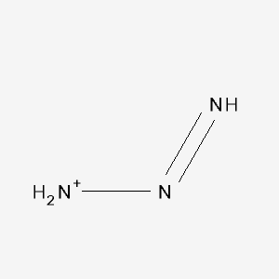
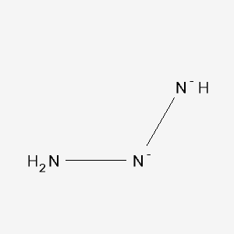













































































Slide 37































































Data normalization algorithms routinely go amuck
Data normalization algorithms are in our workflows
Data normalization algorithms do not reliably ‘understand’ chemistry
Normalization algorithms everywhere are ‘improving’ our chemistry…

Slide 38

“RoboChem” apocalypse?
Image credit:
http://vignette2.wikia.nocookie.net/terminator/images/3/3e/Judgementday.jpg/revision/latest?cb=20090419205037

Slide 39

The chemical information divide
understanding
v
Algorithms are essential for us to do our work .. yet we are in a seemingly endless struggle where they are destroying our human curated content one normalization at a time
Image credit:
http://screencrush.com/files/2017/05/TG_1200x628_Zaic_2017_0317.jpeg

Slide 40
The need for community best practices How do I detect if normalization did something (bad) to my structure?
After you save a chemical in a file, open it back up
Is it the same as what you provided?
Compute descriptor
E.g., InChIKey
Compare descriptor
Still same? If not, why?
Compute
Open
Save
Compare

Slide 41

How to minimize normalization data corruption?
Retain original content (so you can go back)
Avoid re-normalizing structure (as-is possible)
Don’t assume normalization is flawless
Validate your software and workflows
AND each new version
Validation
Can still read your content?
Still interpreted the same?
Compute/compare descriptors (e.g., InChIKey)
Did it change? If so, why?
Compare software and workflows
Report issues
Image credit:
https://cdn.yourstory.com/wp-content/uploads/2015/07/idea-validation-yourstory.jpg

Slide 42
Validation testing to detect data corruption
Such validation approaches won’t find everything but should tell you if you flipped stereo centers or changed connectivity
SDF
SMILES
SDF
Do the InChIKeys match up?
InChIKey1
InChIKey2
InChIKey3
Before
Transform
After
InChIKey1
InChIKey2
InChIKey3
SMILES
SDF
SMILES
Transform might be:
(Re)compute 2-D coordinates
Aromaticity detection
…
P.S. can you compute an InChIKey without normalization happening in your testing environment?

Slide 43


You can help improve chemical informatics
Image credit:
http://www.idreamcareer.com/img/blog/1449649713-make-a-difference.jpg
Image credit: https://media.licdn.com/mpr/mpr/shrinknp_400_400/AAEAAQAAAAAAAAcPAAAAJDFjOTk4YzRiLWJiZTItNDBkNi1hYTYyLTJkOTFiZTBlNTMzMQ.jpg
Feel free to email me for information .. evan.bolton@nih.gov

Slide 44
Call for Interest!
COMM NITY
We Need U
Improve interoperability and accuracy of chemical data exchange
Promote interchange of chemical structures, transformations, functional group definitions and other information
Participate in a community driven process to extend machine-readable open chemical representations

Slide 45
Open Structure formats!
SMILES, SMARTS, CTAB/MOL/SDF
Broad adoption across toolkits, chemical drawing tools, chemistry applications, and within chemical data storage systems
Multiple dialects and extensions in use and no open and up-to-date reference documents describing these formats
Significant barriers for interoperability and accurate interchange of chemical information
NEED OPEN STANDARDS:
Freely accessible and redistributable documentation
Publicly visible process for suggesting and discussing improvements and corrections
Community agreed criteria for interoperability
Clear stewardship

Slide 46
How to formally get involved?
Steve Heller – InChI Trust
IUPAC InChI Subcommittee
https://iupac.org/who-we-are/divisions/division-details/inchi/
Leah McEwen – Cornell Univ.
IUPAC CPCDS - Committee on Publications and Cheminformatics Data Standards
SCDS - Subcommittee on Cheminformatics Data Standards
https://iupac.org/who-we-are/committees/committee-details/?body_code=036
Ian Bruno – CCDC
RDA (Research Data Alliance) - Chemistry Research Data Interest Group
https://www.rd-alliance.org/groups/chemistry-research-data-interest-group.html

Slide 47

Chemical data issues are fundamental
Many answers to “How do I describe my substance and its data?”
Information is made for humans
Need computer understanding of information
Chemical structure representation is insufficient
Publically available chemical information is heavily fragmented
Image credit:
http://agepla.dev.upcom.eu/sites/default/files/Fundamental_Rights-puzzle.jpg

Slide 48
Summary
Standards exist but they are incomplete
Need updated chemical information standards with an emphasis towards machine understanding and interpretation
Need updated standards for biologics (amino acids, nucleic acids, saccharides, lipids) especially in the areas of intermixed line notations and mixed depictions
Need community standards
for common file formats (e.g., SDF, SMILES)
for common algorithms (e.g., stereo perception, aromaticity/kekulization)
Need community standard best practices
for the many folks who like to make tools (e.g., round robin testing, edge case testing)

Slide 49
PubChem Crew …
Evan Bolton
Jie Chen
Tiejun Cheng
Qingliang (Leon) Li
Asta Gindulyte
Jane He
Siqian He
Sunghwan Kim
Ben Shoemaker
Paul Thiessen
Bo Yu
Leonid Zaslavsky
Jian Zhang
Special thanks to the NCBI Help Desk, especially Rana Morris, and past PubChem group members.
This research was supported by the Intramural Research Program of the NIH, National Library of Medicine.

Slide 50
Special thanks
Software collaborators
NextMove Software (Roger Sayle, Noel O’Boyle, John May) , Daniel Lowe
Xemistry GmbH (Wolf D. Ihlenfeldt)
OpenEye Scientific Software
Chemical Health and Safety collaborators
Especially: Leah McEwen (Cornell U.), Ralph Stuart (Keene State College)
Chemical Ontology Collaborators
Especially: Yannick Djoumbou, Lutz Weber, Stephen Boyer
Biohackatons, InChI Trust, discussions, and various communications
All PubChem Contributors and Collaborators

Slide 51

Have any questions?

Slide 52

Get involved!
“We need you” image credit:
https://cdn.kualo.com/website/weneedyouwide.png

